Slide 1

BLOCKCHAIN
Basic Concepts and
Definitions
Sunitha R
Department of Computer Science Engineering

Slide 2

BLOCKCHAIN
Blockchain Introduction
Sunitha R
Department of Computer Science Engineering

Slide 3
BLOCKCHAIN
What is Blockchain?
A technology that:
Permits transactions to be gathered into blocks and recorded:
Cryptographically chains blocks in chronological order: and
Allows the resulting ledger to be accessed by different servers

Slide 4
BLOCKCHAIN
What is Blockchain?
It is an “Open, Distributed ledger that can record transactions between two parties in a Verifiable and Permanent way”
Few keywords like
Open (Accessible to all)
Distributed or Decentralized (No single party control)
Verifiable (Everyone can the validity of the information)
Permanent (The information is persistent)

Slide 5
BLOCKCHAIN
Traditional way of sharing documents

Slide 6
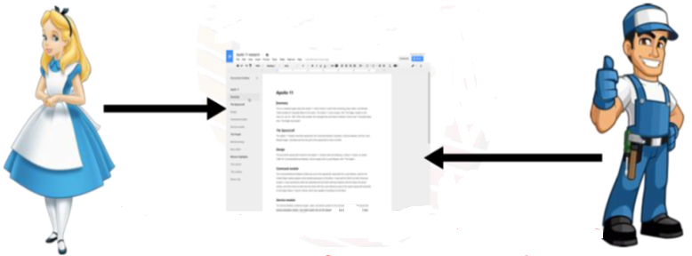
BLOCKCHAIN
Shared Google Doc
Shared Google Doc: both the users can edit simultaneously

Slide 7
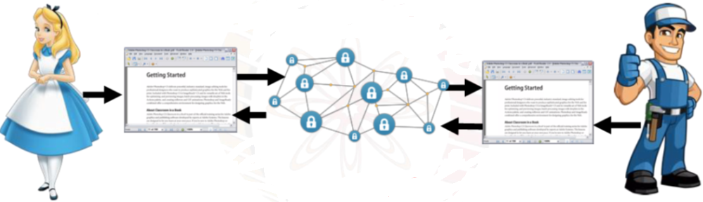
BLOCKCHAIN
Need for Blockchain
Solution to the problems of Traditional way of sharing documents is Blockchain (Internet database).
Everyone edits data on their local copy of the document, the Internet will take care of Ensuring consistency
It is a Decentralization system.

Slide 8
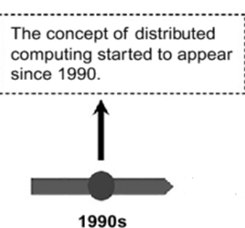
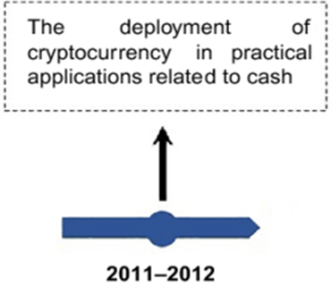
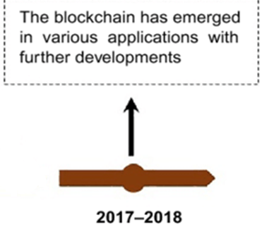
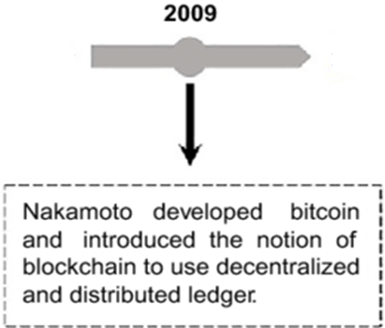
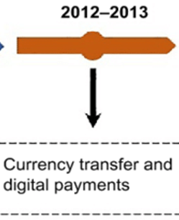
BLOCKCHAIN
History of Blockchain

Slide 9
BLOCKCHAIN
History of Blockchain
Bitcoin is built on the foundation of blockchain, which serves as Bitcoin’s shared ledger.
Consider Blockchain as an operating system, such as Microsoft Windows or MacOS.
Bitcoin as only one of the many applications that can run on the operating system.
Bitcoin and blockchain are not the same.
Blockchain provides the means to record and store Bitcoin transactions.
but blockchain has many uses beyond Bitcoin.
Bitcoin is only the first use case for blockchain.

Slide 10
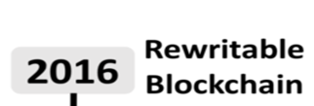
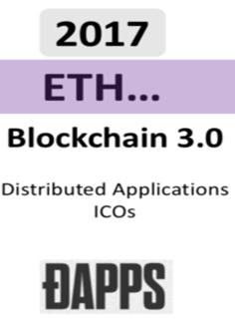
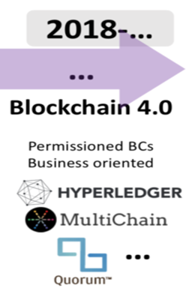
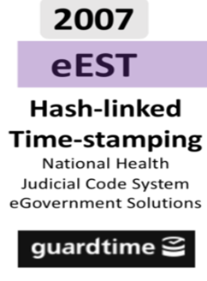
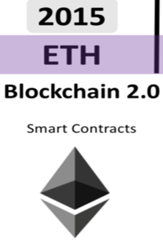
BLOCKCHAIN
Evolution of Blockchain

Slide 11
BLOCKCHAIN
Versions of Blockchain
Blockchain 1.0: Currency
Blockchain 2.0: Smart Contracts
Blockchain 3.0: Dapps
Bloackchain 4.0:
Notes:
Blockchain 1.0: Currency
The implementation of DLT (distributed ledger technology) led to its first and obvious application: cryptocurrencies. This allows financial transactions based on blockchain technology. It is used in currency and payments. Bitcoin is the most prominent example in this segment.
Blockchain 2.0: Smart Contracts
The new key concepts are Smart Contracts, small computer programs that "live" in the blockchain. They are free computer programs that execute automatically, and check conditions defined earlier like facilitation, verification or enforcement. It is used as a replacement for traditional contracts.
Blockchain 3.0: DApps:
DApps is an abbreviation of decentralized application. It has their backend code running on a decentralized peer-to-peer network. A DApp can have frontend code and user interfaces written in any language that can make a call to its backend, like a traditional Apps.

Slide 12
BLOCKCHAIN
Bitcoin versus Blockchain
Bitcoin and blockchain are not the same.
Blockchain provides the means to record and store Bitcoin transactions, but blockchain has many uses beyond Bitcoin.
Bitcoin is only the first use case for blockchain.
Notes:
Blockchain 1.0: Currency
The implementation of DLT (distributed ledger technology) led to its first and obvious application: cryptocurrencies. This allows financial transactions based on blockchain technology. It is used in currency and payments. Bitcoin is the most prominent example in this segment.
Blockchain 2.0: Smart Contracts
The new key concepts are Smart Contracts, small computer programs that "live" in the blockchain. They are free computer programs that execute automatically, and check conditions defined earlier like facilitation, verification or enforcement. It is used as a replacement for traditional contracts.
Blockchain 3.0: DApps:
DApps is an abbreviation of decentralized application. It has their backend code running on a decentralized peer-to-peer network. A DApp can have frontend code and user interfaces written in any language that can make a call to its backend, like a traditional Apps.

Slide 13
BLOCKCHAIN
Blockchain vs Database
Notes:
Blockchain 1.0: Currency
The implementation of DLT (distributed ledger technology) led to its first and obvious application: cryptocurrencies. This allows financial transactions based on blockchain technology. It is used in currency and payments. Bitcoin is the most prominent example in this segment.
Blockchain 2.0: Smart Contracts
The new key concepts are Smart Contracts, small computer programs that "live" in the blockchain. They are free computer programs that execute automatically, and check conditions defined earlier like facilitation, verification or enforcement. It is used as a replacement for traditional contracts.
Blockchain 3.0: DApps:
DApps is an abbreviation of decentralized application. It has their backend code running on a decentralized peer-to-peer network. A DApp can have frontend code and user interfaces written in any language that can make a call to its backend, like a traditional Apps.

Slide 14
BLOCKCHAIN
Public Ledger
Every node maintains a local copy of the global data sheet.
The system ensure the consistency among the local copies
The local copy at every node is identical.
The local copies are always updated based the global information.
Notes:
Blocks store information about transactions, like the date, time, and amount of your most recent purchase from purchase.
Blocks store information about who is participating in transactions.
Blocks store information that distinguishes them from other blocks.

Slide 15
BLOCKCHAIN
An Example of Public Ledger from Banking Sectors
PL of Alice
PL of Bob
80
PL of Eve
PL of Jane
30

Slide 16

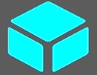
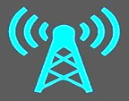
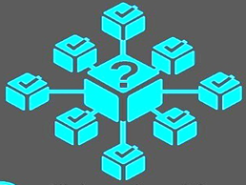

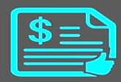
BLOCKCHAIN
How it Works?
A user request for a Transaction
A block representing the transaction is created
A block is broadcasted to all nodes in the network
Transaction will get s verified and executed
Block will be added to the chain
All the nodes validate the block and the transactions

Slide 17
BLOCKCHAIN
Key features
Anonymity
Immutability
Peer-to Peer
Logical Computation
Distributed
Transparency

Slide 18
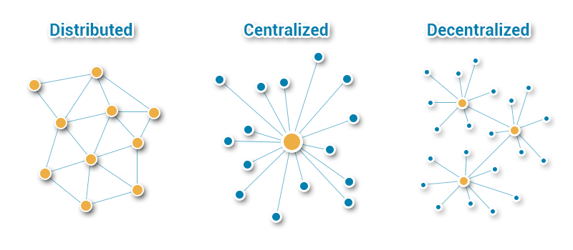
BLOCKCHAIN
Distributed

Slide 19
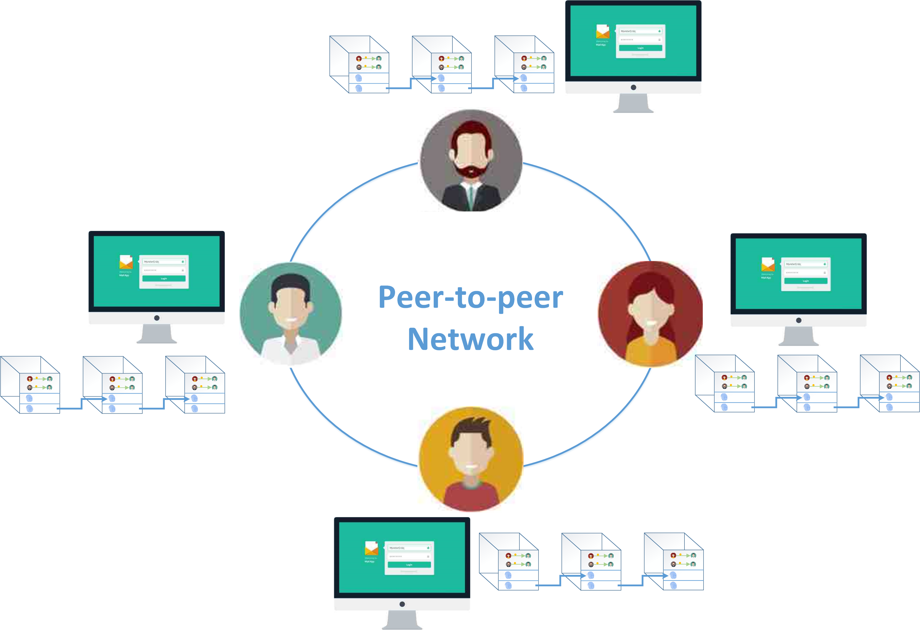
BLOCKCHAIN
Peer-to Peer

Slide 20
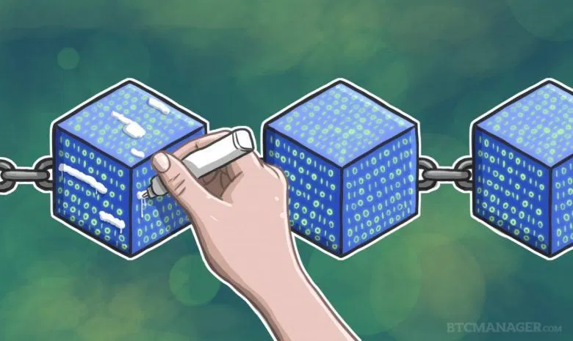
BLOCKCHAIN
Immutability

Slide 21
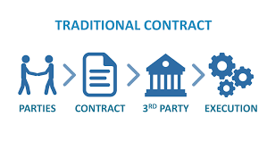
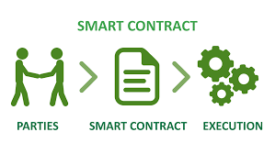
BLOCKCHAIN
Logical Computation

Slide 22
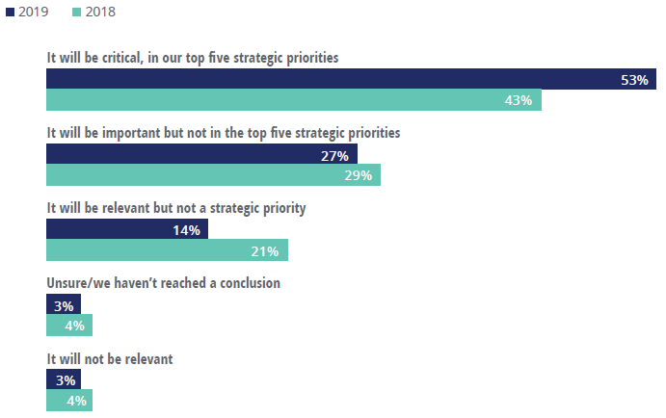
BLOCKCHAIN
Blockchain Usage
Deloitte conducted survey Feb 8 to Mar 4, 2019 as a primary research vehicle to gain greater insights into the overall attitudes and investments in the blockchain
Source: Deloitte’s Global Blockchain Survey,2018 and 2019

Slide 23
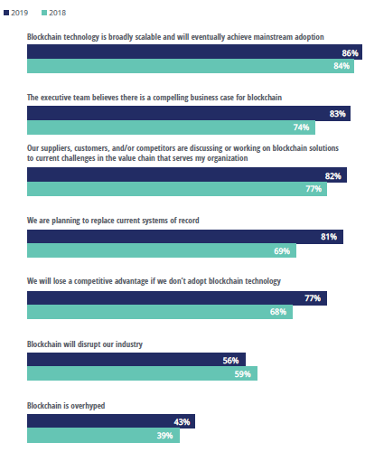
BLOCKCHAIN
Blockchain Enabled Solutions
Source: Deloitte’s Global Blockchain Survey,2018 and 2019

Slide 24
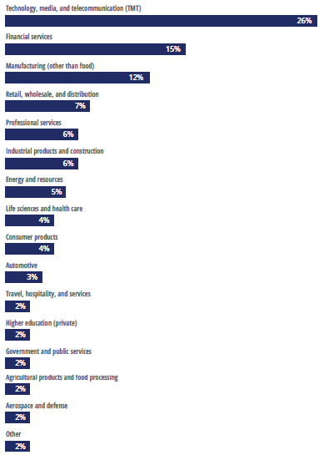
BLOCKCHAIN
Blockchain for Various industries
Source: Deloitte’s Global Blockchain Survey,2018 and 2019

Slide 25
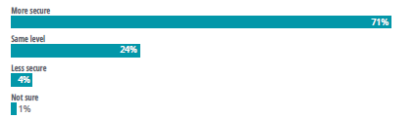
BLOCKCHAIN
BLOCKCHAIN
Blockchain for Security
Source: Deloitte’s Global Blockchain Survey,2018 and 2019

Slide 26
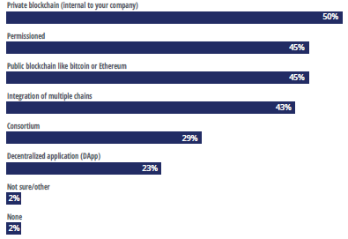
BLOCKCHAIN
Blockchain Models
Source: Deloitte’s Global Blockchain Survey,2018 and 2019

Slide 27
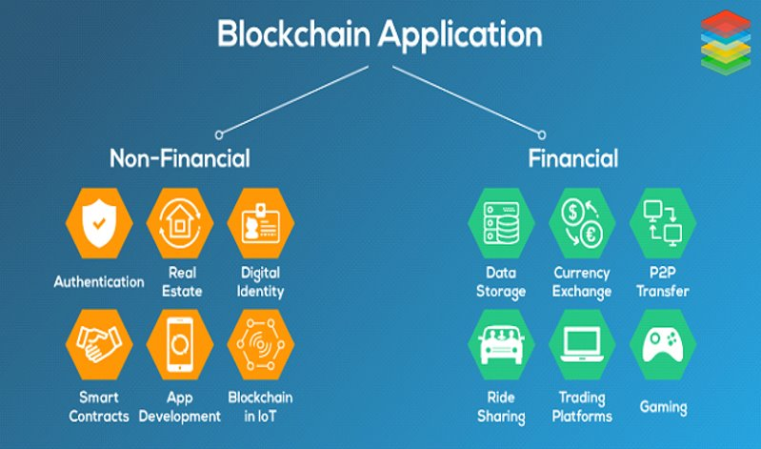
BLOCKCHAIN
Applications

Slide 28
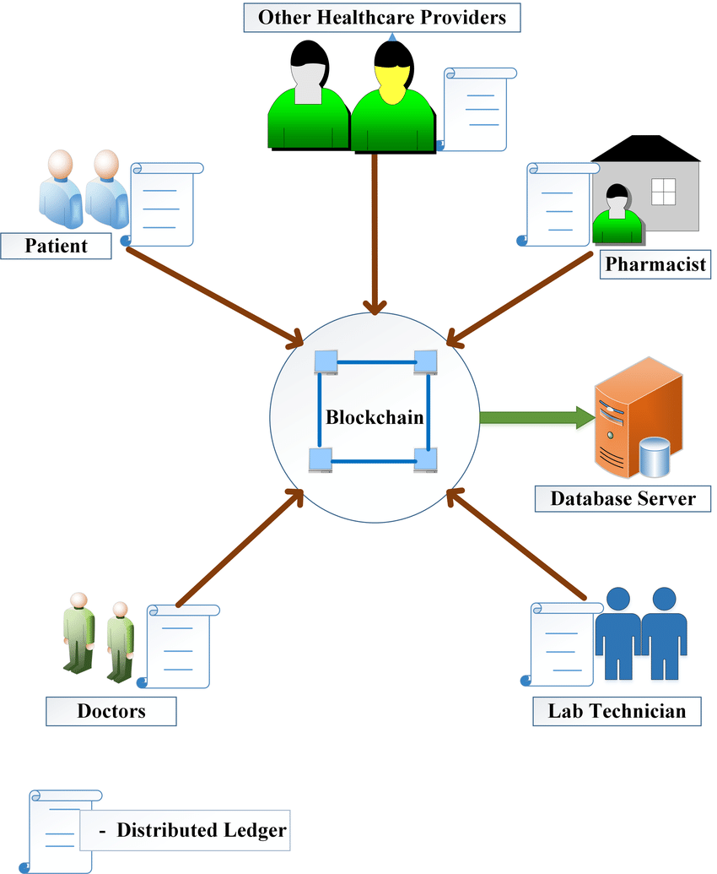
BLOCKCHAIN
BLOCKCHAIN FOR HEALTHCARE

Slide 29
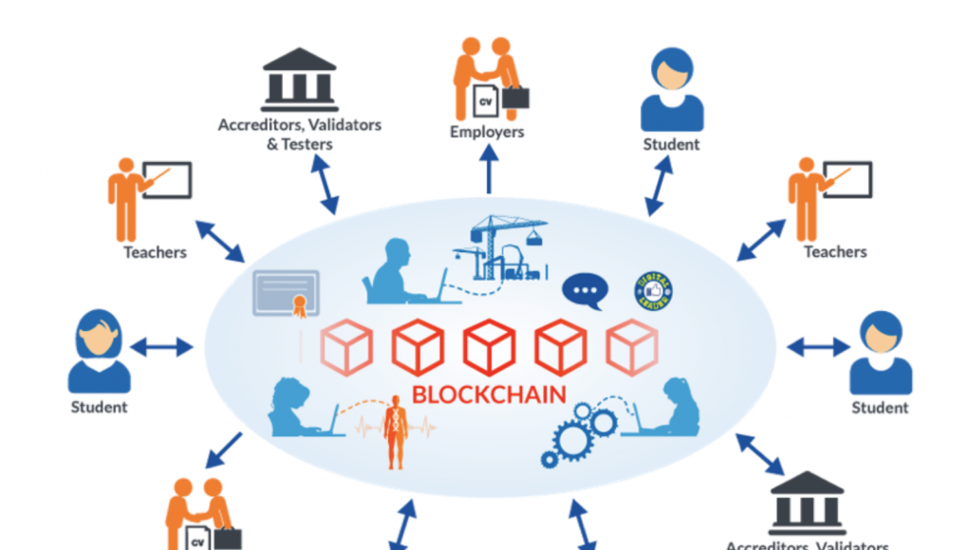
BLOCKCHAIN
BLOCKCHAIN FOR EDUCATION

Slide 30
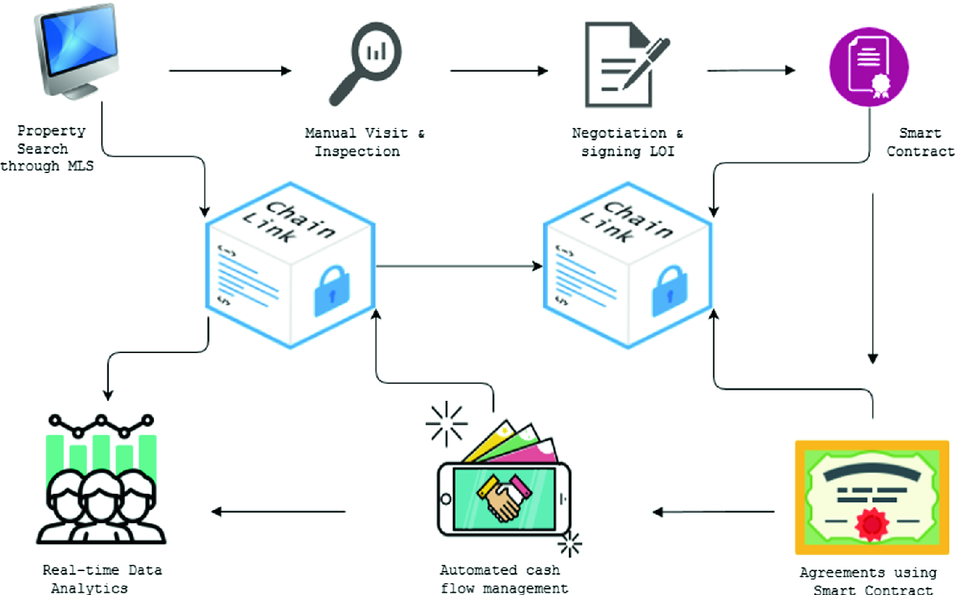
BLOCKCHAIN
BLOCKCHAIN FOR REAL ESTATE

Slide 31
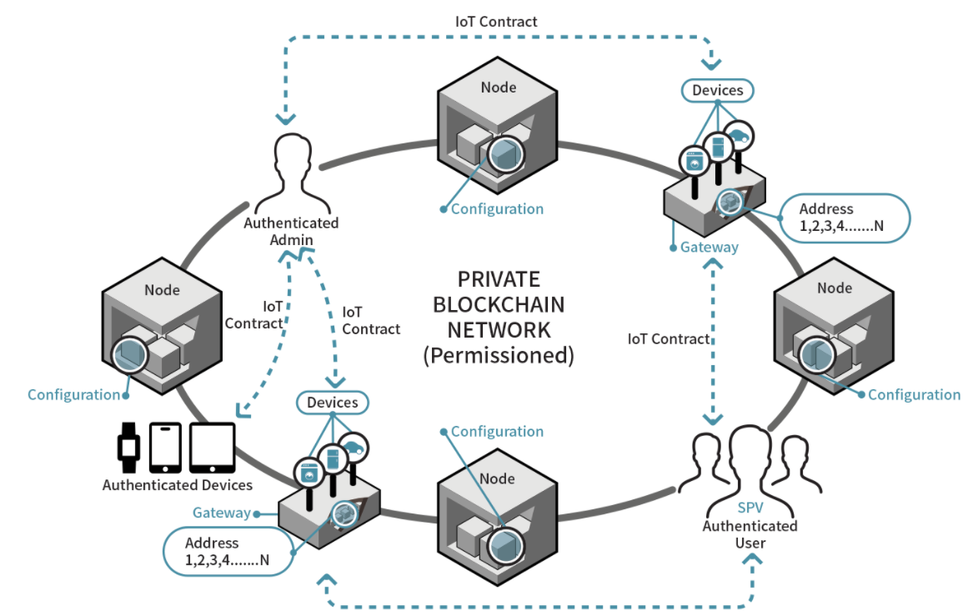
BLOCKCHAIN
BLOCK CHAIN FOR IOT

Slide 32
BLOCKCHAIN
BLOCKCHAIN FOR IoT
There is a lot of development work being done for applying blockchain to IoT networks, specifically to address security issues.
Watson IoT
Maru
Telstra
Notes:
There is a lot of development work being done for applying blockchain to IoT networks, specifically to address security issues.
IBM has integrated the Watson IoT Platform with Blockchain to help companies create use cases using blockchain and IoT.
Chain of Things (CoT) is developing Maru, an integrated blockchain and IoT hardware solution to solve issues with identity, security and interoperability of IoT networks.
Telstra has successfully verified real-time tamper detection testing with blockchain. As a result, the company has enabled blockchain with biometric security for its secure smart home offerings.

Slide 33
BLOCKCHAIN
Development Platforms
Ethereum
Hyperledger Fabric
IBMs Blue Mix
RIPPLE
Multichain

Slide 34
BLOCKCHAIN
Supplemental readings
https://blockchainhub.net/
https://www.bosch.com/stories/blockchain-technology-explained/
https://ieeexplore.ieee.org/document/8946277
https://ieeexplore.ieee.org/document/8840920
https://www.youtube.com/watch?v=yubzJw0uiE4

Slide 35
THANK YOU
Sunitha R
Department of Computer Science Engineering
sunithar@pes.edu
+91 80 6666 3333 Extn 721

